Slide 1










ARTIFICIAL INTELLIGENCE: PRESENTATION
ML Models
Data Visulization
METEOR
SIMULATOR:
IMPACT ANALYSIS
Artificial
Intelligence
Presented by:
Aden & Ibrahim
Data Anlaysis

Slide 2


TABLE OF CONTENTS
Objectives
Tools & Technologies
Methodologies
Data Collection & Cleaning
Feature Extraction
Predictive Analysis
Conclusion

Slide 3
OBJECTIVES
Data Collection.
Clean and preprocess data.
Train ML models.
Generate analysis reports, plots, and graphs.
Implement AI components.
Create a user-friendly front end using PySimpleGUI.

Slide 4
TOOLS & TECHNOLOGIES
PySimpleGUI
pandas
matplotlib
geopandas
shapely
BS4
Random Forest
MinMaxScaler
KNN and XGB models
RFE
map
seaborn
openai
pyttsx3
openAI
RobustScaler

Slide 5




METHODOLOGIES
DS TECHNIQUES
ML MODELS
Collection, Cleaning, Scraping and Analysis.
Random Forest, RFE and
XGB.
AI TOOLS
PLOTTING AND ANALYSIS
KNN, Chat GPT Integration & Text-to-Speech Feature.
Plots, Graphs and
Predictive Analysis.

Slide 6
METHODOLOGIES (CONT.)
DATA SCIENCE
AI
MACHINE LEARNING
Web Scraping: to get dataset from site as csv.
Data Cleaning: get rid of irrelevant features/data.
Data Analysis: to understand and visualize our data.
KNN: to conduct predictive analysis.
Chat GPT: for runtime text generation.
Text-to-Speech: ease of use & better engagement.
K-Means Cluster: to compare different datasets.
Random Forest: for feature selection & extraction.
RFE: for cross-checking purposes with RF.
PREDICTIVE ANALYSIS

Slide 7





DATA COLLECTION
AND
CLEANING
1
COLLECTING DATA
2
DATA CLEANING
2 Main datasets for training and prediction purposes.
Dataset 1 unavailable as csv online, so we used
Dataset 2 publicly available online.
Removed unnecessary features, duplications and data prone to error.
web scraping.
Dataset 1.
Dataset 2.

Slide 8
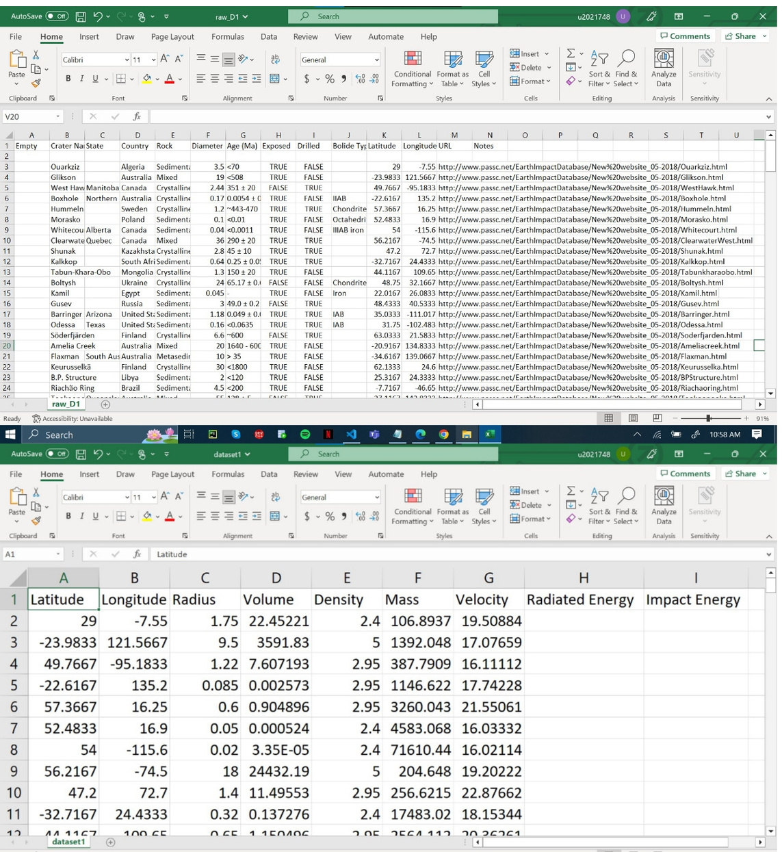
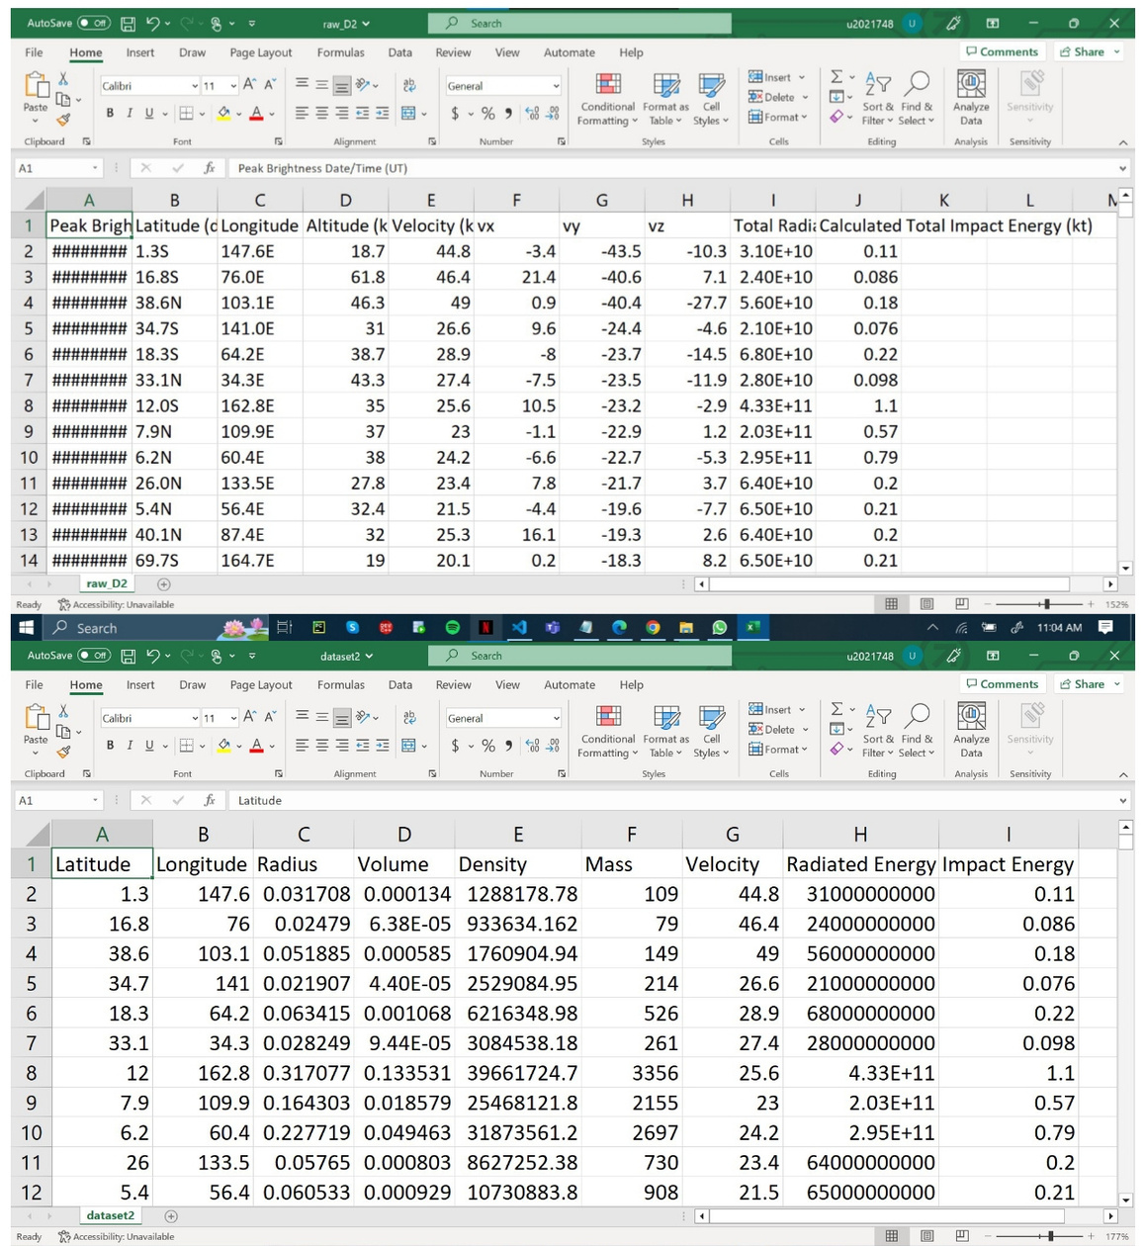

Slide 9



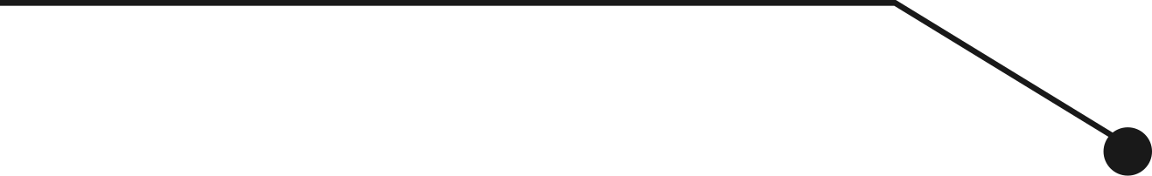

FEATURE EXTRACTION
Volume
Mass
Feature selection and extraction before training models.
Random Forest and RFE to determine feature rankings.
Extract most imp features only and use those for training.
Radius
Features Ranking

Slide 10
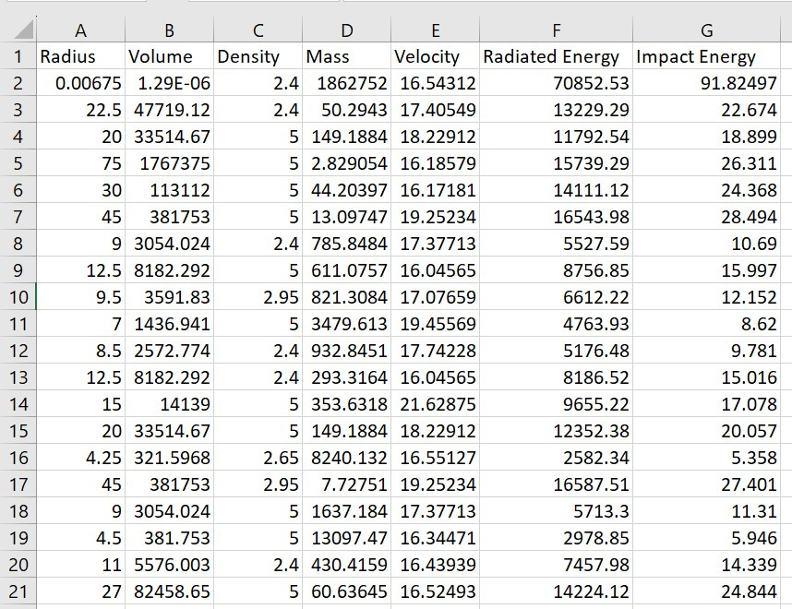
KNN: IDEAL DATASET
PREDICTIVE ANALYSIS
Used KNN for classification purposes.
Trained a model and performed various predictions.
Developed an ideal dataset to be used for analyitical purposes.

Slide 11

CONCLUSION
Successful prediction and analysis of impact of meteors.
The integration of AI components improved the user experience.
The user-friendly front end facilitated easy interaction of the program.

